Slide 1

Chapter 1
Getting Started
Slides prepared by Rose Williams, Binghamton University
Kenrick Mock, University of Alaska Anchorage
Copyright © 2016 Pearson Inc. All rights reserved.

Slide 2
Introduction To Java
Most people are familiar with Java as a language for Internet applications
We will study Java as a general purpose programming language

Slide 3
Introduction To Java
The syntax of expressions and assignments is similar to C/C++
But relatively different than Python
Details concerning the handling of strings and console output is new

Slide 4
Introduction To Java
Source program translation is different from Python
Compiler (vs. Interpreter)
Complete source code is first verified for syntax errors
Then it is translated into an executable program of machine language specific to the platform (OS + HW)

Slide 5
Introduction To Java
The step 2 of compilation in Java is different from other compiler-based languages such as C/C++
Source code is translated to a byte code (an intermediate language) which is not specific to any platform
This byte code is can not be executed directly
Requires a special JVM (Java virtual machine) for that platform and is executed inside that environment

Slide 6
Objects and Methods
Java is an object-oriented programming (OOP) language
Programming methodology that views a program as consisting of objects that interact with one another by means of actions (called methods)
Objects of the same kind are said to have the same type or be in the same class

Slide 7
Terminology Comparisons
Other high-level languages have constructs called procedures, methods, functions, and/or subprograms
These types of constructs are called methods in Java
All programming constructs in Java, including methods, are part of a class

Slide 8
Java Program vs. Python
class A {
//some code here
}
class B {
//some code here
}
def aFunction():
A = 25
print(A)
B = 30
if B > 25:
aFunction()
All the code is inside one or more “classes” for which the boundary is marked by {}

Slide 9
Java Method vs. Python Function
int aMethod(int x, int y){
//some code here
anotherMethod();
}
definition
definition
def aFunction(x,y):
A = 25
print(A)
B = 30
if B > 25:
aFunction()
Invocation/Call
Must be inside a class
Must specify the return type
Must specify the type of parameters
Cannot return more than one values

Slide 10
Java Scope vs. Python
class A {
//some code here
int aMethod(){
//some code here
{//another scope level
}
}
}
def aFunction:
A = 25
print(A)
B = 30
if B > 25:
aFunction()
A set of {} defines a new scope level
Indentation is optional; if compiler does not see a new set of {}, then it is the same scope

Slide 11
Java Program Execution vs. Python
class A {
public static void main(String [] a)
{
//some code here
}
}
def aFunction:
A = 25
print(A)
B = 30
Requires a special method to initiate execution
This special method must have the header public static void main (String [] args)
Only code in “main” or invoked from “main” will execute

Slide 12
Java Application Programs
Two common types of Java programs are applications and applets
A Java application program or "regular" Java program is a class with a method named main
When a Java application program is run, the run-time system automatically invokes the method named main
All Java application programs start with the main method

Slide 13
Applets
A Java applet (little Java application) is a Java program that is meant to be run from a Web browser
Can be run from a location on the Internet
Can also be run with an applet viewer program for debugging
Applets always use a windowing interface
In contrast, application programs may use a windowing interface or console (i.e., text) I/O

Slide 14
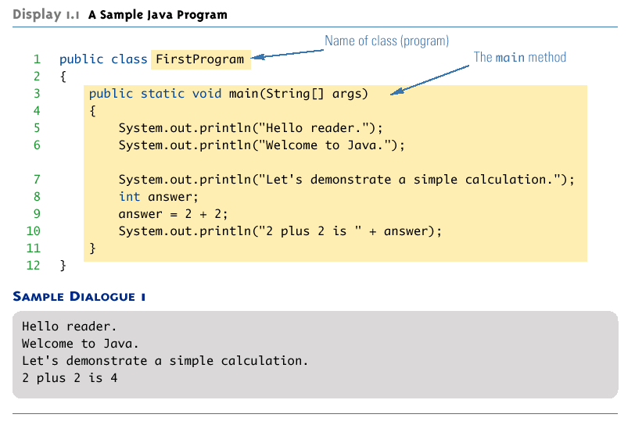
A Sample Java Application Program

Slide 15
Method is important
The actual code is inside the methods which are inside classes
In a class but outside the method, you can only define/initialize variables; no other code is permitted
Remember from Python: a = 25
A method is identified by its signature
public static void main(String [] args)

Slide 16
Method Signature
Two things are part of a method signature
Name: case sensitive
Parameter set: count, type, sequence/order
Two methods are different if anything in signature is different
Return type, parameter names and other attributes do not matter
Two or more methods with same signature in the same class are not allowed; considered duplication or redefinition.

Slide 17
Rules for main()
More than one classes can have “main”
You can pick one of the “main” to start program
One class cannot have more than one “main”
Signature rules apply
Only the method with exact same signature and header can be used as start point
public static void main(String [] args)

Slide 18
System.out.println
System.out.println(“Welcome to Java”);
Java programs work by having things called objects perform actions
System.out: an object used for sending output to the screen
The actions performed by an object are called methods
println: the method or action that the System.out object performs

Slide 19
System.out.println
Invoking or calling a method: When an object performs an action using a method
An object is always on the left side of “.”
“System” and “out”
An object can have other objects as member
“out” is member of “System”; between the two “.”

Slide 20
iClicker
Let’s analyze the code below:
How many unique methods are there?
A=0 B=1 C=2 D=4 E=5

Slide 21
iClicker
Let’s analyze the code below:
How many method calls are there?
A=0 B=1 C=2 D=4 E=5

Slide 22
iClicker
Let’s analyze the code below:
How many method definition are there?
A=0 B=1 C=2 D=4 E=5

Slide 23
Class Loader
Java programs are divided into smaller parts called classes
Each class definition is normally in a separate file and compiled separately and has separate byte code file
Class Loader: A program that connects the byte-code of the classes needed to run a Java program
In other programming languages, the corresponding program is called a linker

Slide 24
Compiling a Java Program or Class
More than one classes are possible in a big program
Each “public” class definition must be in a file whose name is the same as the class name followed by .java
The public class FirstProgram must be in a file named FirstProgram.java
More than one non “public” classes can be combined in one .java file
But it is always recommended to write each class in a separate .java file, with its own name
Try/explore all possible file naming variations (IMPORTANT)

Slide 25
Compiling a Java Program or Class
Each class is compiled with the command javac followed by the name of the file in which the class resides
javac FirstProgram.java
The result is a byte-code program whose filename is the same as the class name followed by .class
FirstProgram.class

Slide 26
Running a Java Program
A Java program can be given the run command (java) after all its classes have been compiled
Only run the class that contains the main method (the system will automatically load and run the other classes, if any)
Follow the run command by the name of the class only (no .java or .class extension)
java FirstProgram

Slide 27
Syntax and Semantics
Syntax: The arrangement of words and punctuations that are legal in a language, the grammar rules of a language
Semantics: The meaning of things written while following the syntax rules of a language

Slide 28
Tip: Error Messages
Bug: A mistake in a program
The process of eliminating bugs is called debugging
Syntax error: A grammatical mistake in a program
The compiler can detect these errors, and will output an error message saying what it thinks the error is, and where it thinks the error is

Slide 29
Tip: Error Messages
Run-time error: An error that is not detected until a program is run
The compiler cannot detect these errors: an error message is not generated after compilation, but after execution
Logic error: A mistake in the underlying algorithm for a program
The compiler cannot detect these errors, and no error message is generated after compilation or execution, but the program does not do what it is supposed to do

Slide 30
Variable declarations
Variable declarations in Java are similar to those in other programming languages
Simply give the type of the variable followed by its name and a semicolon
int answer;
int answer = 25;
int answer, question;
int answer = 25, question = 30;

Slide 31
Variable Declarations
Every variable in a Java program must be declared before it is used
A variable declaration tells the compiler what kind of data (type) will be stored in the variable
The type of the variable is followed by one or more variable names separated by commas, and terminated with a semicolon
Variables are typically declared just before they are used or at the start of a block (indicated by an opening brace { )
Basic types in Java are called primitive types
int numberOfBeans;
double oneWeight, totalWeight;

Slide 32
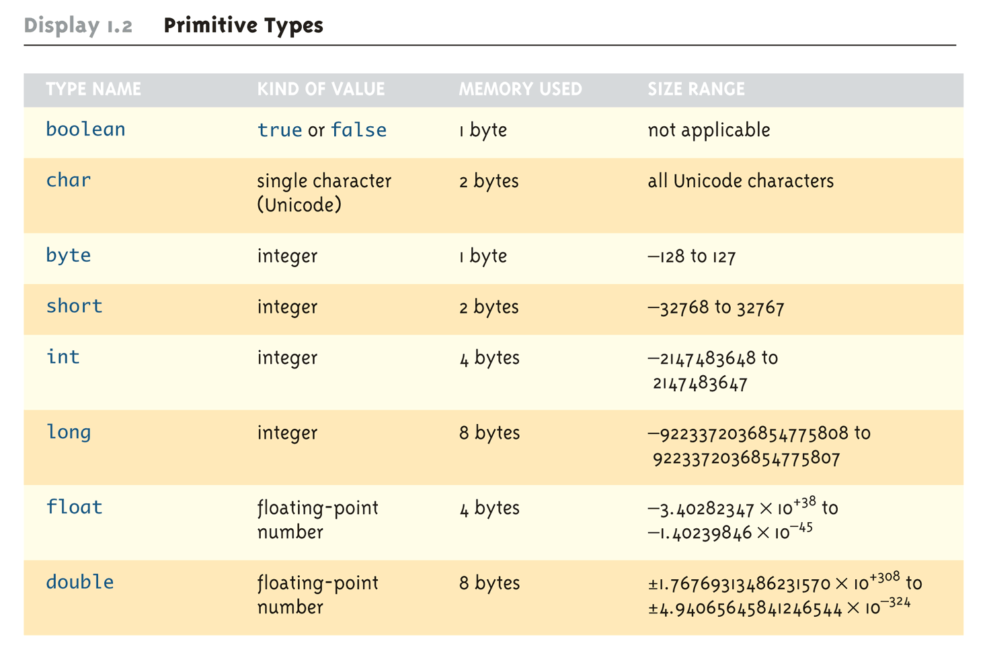
Primitive Types

Slide 33
Assignment Compatibility
In general, the value of one type cannot be stored in a variable of another type
int intVariable = 2.99; //Illegal
The above example results in a type mismatch because a double value cannot be stored in an int variable
However, there are exceptions to this
double doubleVariable = 2;
For example, an int value can be stored in a double type

Slide 34
Assignment Compatibility
More generally, a value of any type in the following list can be assigned to a variable of any type that appears to the right of it
char→byte→short→int→long→float→double
Note that as your move down the list from left to right, the range of allowed values for the types becomes larger
Note that in Java an int cannot be assigned to a variable of type boolean, nor can a boolean be assigned to a variable of type int

Slide 35
Constants
Constant (or literal): An item in Java which has one specific value that cannot change
Constants of an integer type may not be written with a decimal point (e.g., 10)
Constants of a floating-point type can be written in ordinary decimal fraction form (e.g., 367000.0 or 0.000589)
Constant of a floating-point type can also be written in scientific (or floating-point) notation (e.g., 3.67e5 or 5.89e-4)
Note that the number before the e may contain a decimal point, but the number after the e may not

Slide 36
Constants
Constants of type char are expressed by placing a single character in single quotes (e.g., 'Z')
Constants for strings of characters are enclosed by double quotes (e.g., "Welcome to Java")
There are only two boolean type constants, true and false
Note that they must be spelled with all lowercase letters
By default
A constant of integer type is considered of type “int”
A constant of floating type is considered of type “double”

Slide 37
Type Casting
A type cast takes a value of one type and produces a value of another type with an "equivalent" value
If n and m are integers to be divided, and the fractional portion of the result must be preserved, at least one of the two must be type cast to a floating-point type before the division operation is performed
int n, m;
double ans = n / (double)m;
Note that the desired type is placed inside parentheses immediately in front of the variable to be cast
Note also that the type and value of the variable to be cast does not change

Slide 38
More Details About Type Casting
When type casting from a floating-point to an integer type, the number is truncated, not rounded
(int)2.9 evaluates to 2, not 3
When the value of an integer type is assigned to a variable of a floating-point type, Java performs an automatic type cast called a type coercion
double d = 5;
In contrast, it is illegal to place a double value into an int variable without an explicit type cast
int i = 5.5; // Illegal
int i = (int)5.5 // Correct

Slide 39
The Class String
There is no primitive type for strings in Java
The class String is a predefined class in Java that is used to store and process strings
Objects of type String are made up of strings of characters that are written within double quotes
Any quoted string is a constant of type String
"Live long and prosper."
A variable of type String can be given the value of a String object
String blessing = "Live long and prosper.";

Slide 40
Reading
Read the rest of the topics in this slide at home and practice
It is REQUIRED
Read the complete chapter 1
Each section
Practice self test exercise and end problem

Slide 41
iClicker Time
Let’s analyze the code that we have just seen:
String greeting = "Hello";
int count = greeting.length();
System.out.println("Length is " + greeting.length());
Q1: Name of an object?
C
A
D
E
B

Slide 42
iClicker Time
Let’s analyze the code that we have just seen:
String greeting = "Hello";
int count = greeting.length();
System.out.println("Length is " + greeting.length());
Q2: Name of a class?
B
C
A
D
E

Slide 43
iClicker Time
Let’s analyze the code that we have just seen:
String greeting = "Hello";
int count = greeting.length();
System.out.println("Length is " + greeting.length());
Q3: Name of a method?
B
C
A
D
E

Slide 44
iClicker Time
Let’s analyze the code that we have just seen:
String greeting = "Hello";
int count = greeting.length();
System.out.println("Length is " + greeting.length());
Q4: Name of a variable?
B
C
A
D
E

Slide 45
Identifiers
Identifier: The name of a variable or other item (class, method, object, etc.) defined in a program
A Java identifier must not start with a digit, and all the characters must be letters, digits, or the underscore symbol
Java identifiers can theoretically be of any length
Java is a case-sensitive language: Rate, rate, and RATE are the names of three different variables

Slide 46
Identifiers
Keywords and Reserved words: Identifiers that have a predefined meaning in Java
Do not use them to name anything else
public class void static
Predefined identifiers: Identifiers that are defined in libraries required by the Java language standard
Although they can be redefined, this could be confusing and dangerous if doing so would change their standard meaning
System String println

Slide 47
Naming Conventions
Start the names of variables, methods, and objects with a lowercase letter, indicate "word" boundaries with an uppercase letter, and restrict the remaining characters to digits and lowercase letters
topSpeed bankRate1 timeOfArrival
Start the names of classes with an uppercase letter and, otherwise, adhere to the rules above
FirstProgram MyClass String

Slide 48
Using = and +
In Java, the equal sign (=) is used as the assignment operator
The variable on the left side of the assignment operator is assigned the value of the expression on the right side of the assignment operator
answer = 2 + 2;
In Java, the plus sign (+) can be used to denote addition (as above) or concatenation
Using +, two strings can be connected together
System.out.println("2 plus 2 is " + answer);

Slide 49
Assignment Statements With Primitive Types
In Java, the assignment statement is used to change the value of a variable
The equal sign (=) is used as the assignment operator
An assignment statement consists of a variable on the left side of the operator, and an expression on the right side of the operator
Variable = Expression;
An expression consists of a variable, number, or mix of variables, numbers, operators, and/or method invocations
temperature = 98.6;
count = numberOfBeans;

Slide 50
Assignment Statements With Primitive Types
When an assignment statement is executed, the expression is first evaluated, and then the variable on the left-hand side of the equal sign is set equal to the value of the expression
distance = rate * time;
Note that a variable can occur on both sides of the assignment operator
count = count + 2;
The assignment operator is automatically executed from right-to-left, so assignment statements can be chained
number2 = number1 = 3;

Slide 51
Tip: Initialize Variables
A variable that has been declared but that has not yet been given a value by some means is said to be uninitialized
In certain cases an uninitialized variable is given a default value
It is best not to rely on this
Explicitly initialized variables have the added benefit of improving program clarity

Slide 52
Tip: Initialize Variables
The declaration of a variable can be combined with its initialization via an assignment statement
int count = 0;
double distance = 55 * .5;
char grade = 'A';
Note that some variables can be initialized and others can remain uninitialized in the same declaration
int initialCount = 50, finalCount;

Slide 53
Shorthand Assignment Statements
Shorthand assignment notation combines the assignment operator (=) and an arithmetic operator
It is used to change the value of a variable by adding, subtracting, multiplying, or dividing by a specified value
The general form is
Variable Op = Expression
which is equivalent to
Variable = Variable Op (Expression)
The Expression can be another variable, a constant, or a more complicated expression
Some examples of what Op can be are +, -, *, /, or %

Slide 54
Shorthand Assignment Statements
Example: | Equivalent To:
count += 2; | count = count + 2;
sum -= discount; | sum = sum – discount;
bonus *= 2; | bonus = bonus * 2;
time /= rushFactor; | time = time / rushFactor;
change %= 100; | change = change % 100;
amount *= count1 + count2; | amount = amount * (count1 + count2);

Slide 55
Arithmetic Operators and Expressions
As in most languages, expressions can be formed in Java using variables, constants, and arithmetic operators
These operators are + (addition), - (subtraction), * (multiplication), / (division), and % (modulo, remainder)
An expression can be used anyplace it is legal to use a value of the type produced by the expression

Slide 56
Arithmetic Operators and Expressions
If an arithmetic operator is combined with int operands, then the resulting type is int
If an arithmetic operator is combined with one or two double operands, then the resulting type is double
If different types are combined in an expression, then the resulting type is the right-most type on the following list that is found within the expression
char→byte→short→int→long→float→double
Exception: If the type produced should be byte or short (according to the rules above), then the type produced will actually be an int

Slide 57
Parentheses and Precedence Rules
An expression can be fully parenthesized in order to specify exactly what subexpressions are combined with each operator
If some or all of the parentheses in an expression are omitted, Java will follow precedence rules to determine, in effect, where to place them
However, it's best (and sometimes necessary) to include them

Slide 58
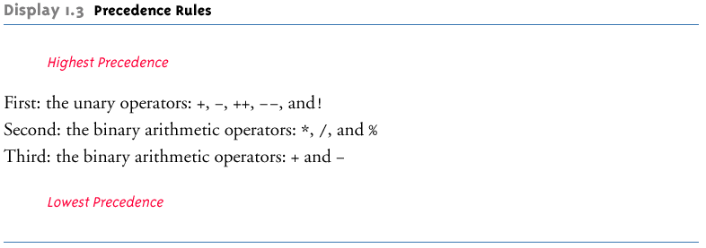
Precedence Rules

Slide 59
Precedence and Associativity Rules
When the order of two adjacent operations must be determined, the operation of higher precedence (and its apparent arguments) is grouped before the operation of lower precedence
base + rate * hours is evaluated as
base + (rate * hours)
When two operations have equal precedence, the order of operations is determined by associativity rules

Slide 60
Precedence and Associativity Rules
Unary operators of equal precedence are grouped right-to-left
+-+rate is evaluated as +(-(+rate))
Binary operators of equal precedence are grouped left-to-right
base + rate + hours is evaluated as
(base + rate) + hours
Exception: A string of assignment operators is grouped right-to-left
n1 = n2 = n3; is evaluated as n1 = (n2 = n3);

Slide 61
Pitfall: Round-Off Errors in Floating-Point Numbers
Floating point numbers are only approximate quantities
Mathematically, the floating-point number 1.0/3.0 is equal to 0.3333333 . . .
A computer has a finite amount of storage space
It may store 1.0/3.0 as something like 0.3333333333, which is slightly smaller than one-third
Computers actually store numbers in binary notation, but the consequences are the same: floating-point numbers may lose accuracy

Slide 62
Integer and Floating-Point Division
When one or both operands are a floating-point type, division results in a floating-point type
15.0/2 evaluates to 7.5
When both operands are integer types, division results in an integer type
Any fractional part is discarded
The number is not rounded
15/2 evaluates to 7
Be careful to make at least one of the operands a floating-point type if the fractional portion is needed

Slide 63
The % Operator
The % operator is used with operands of type int to recover the information lost after performing integer division
15/2 evaluates to the quotient 7
15%2 evaluates to the remainder 1
The % operator can be used to count by 2's, 3's, or any other number
To count by twos, perform the operation number % 2, and when the result is 0, number is even

Slide 64
Increment and Decrement Operators
The increment operator (++) adds one to the value of a variable
If n is equal to 2, then n++ or ++n will change the value of n to 3
The decrement operator (--) subtracts one from the value of a variable
If n is equal to 4, then n-- or --n will change the value of n to 3

Slide 65
Increment and Decrement Operators
When either operator precedes its variable, and is part of an expression, then the expression is evaluated using the changed value of the variable
If n is equal to 2, then 2*(++n) evaluates to 6
When either operator follows its variable, and is part of an expression, then the expression is evaluated using the original value of the variable, and only then is the variable value changed
If n is equal to 2, then 2*(n++) evaluates to 4

Slide 66
Concatenation of Strings
Concatenation: Using the + operator on two strings in order to connect them to form one longer string
If greeting is equal to "Hello ", and javaClass is equal to "class", then greeting + javaClass is equal to "Hello class"
Any number of strings can be concatenated together
When a string is combined with almost any other type of item, the result is a string
"The answer is " + 42 evaluates to
"The answer is 42"

Slide 67
String Methods
The String class contains many useful methods for string-processing applications
A method in String class is called by writing a String object, a dot, the name of the method, and a pair of parentheses to enclose any arguments
If a String method returns a value, then it can be placed anywhere that a value of its type can be used
String greeting = "Hello";
int count = greeting.length();
System.out.println("Length is " + greeting.length());
Always count from zero when referring to the position or index of a character in a string

Slide 68
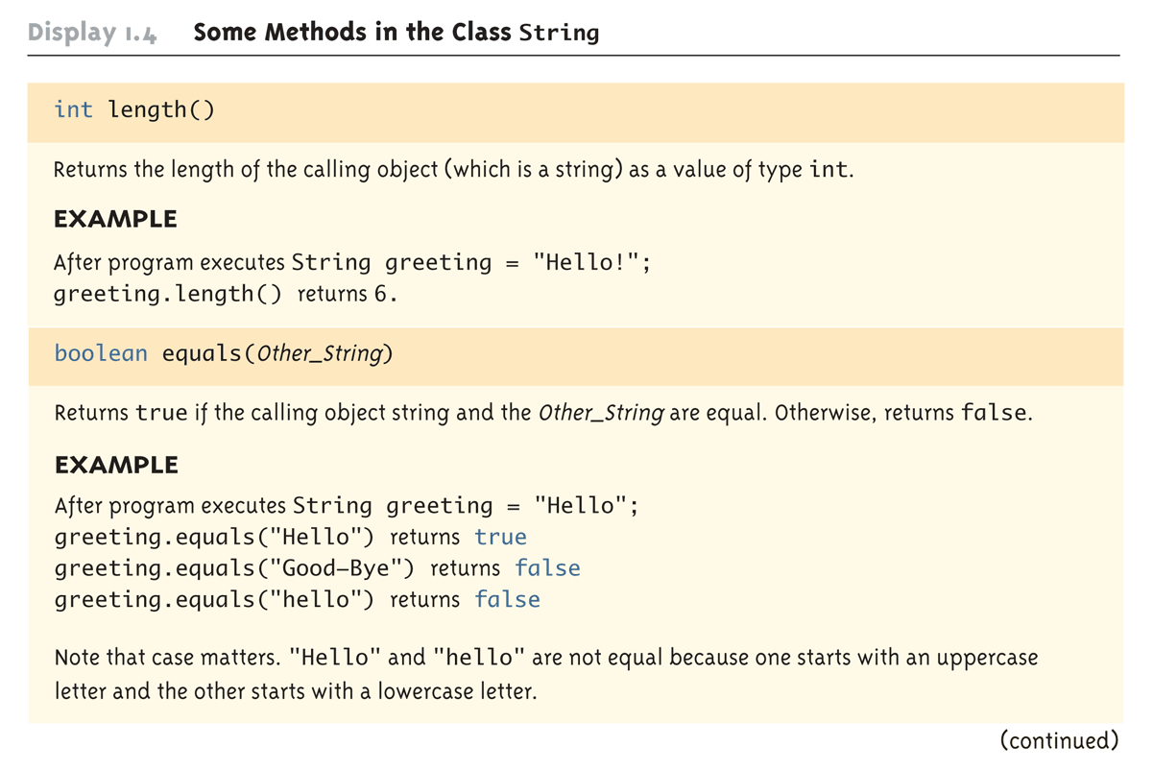
Some Methods in the Class String (Part 1 of 8)

Slide 69
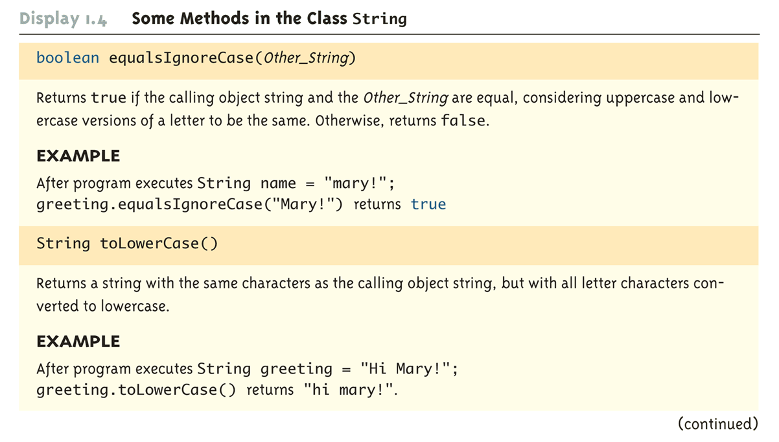
Some Methods in the Class String (Part 2 of 8)

Slide 70
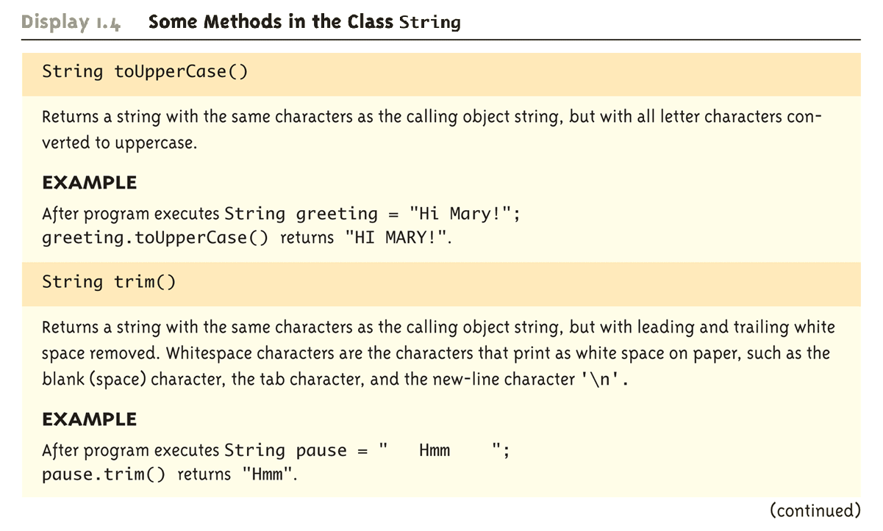
Some Methods in the Class String (Part 3 of 8)

Slide 71
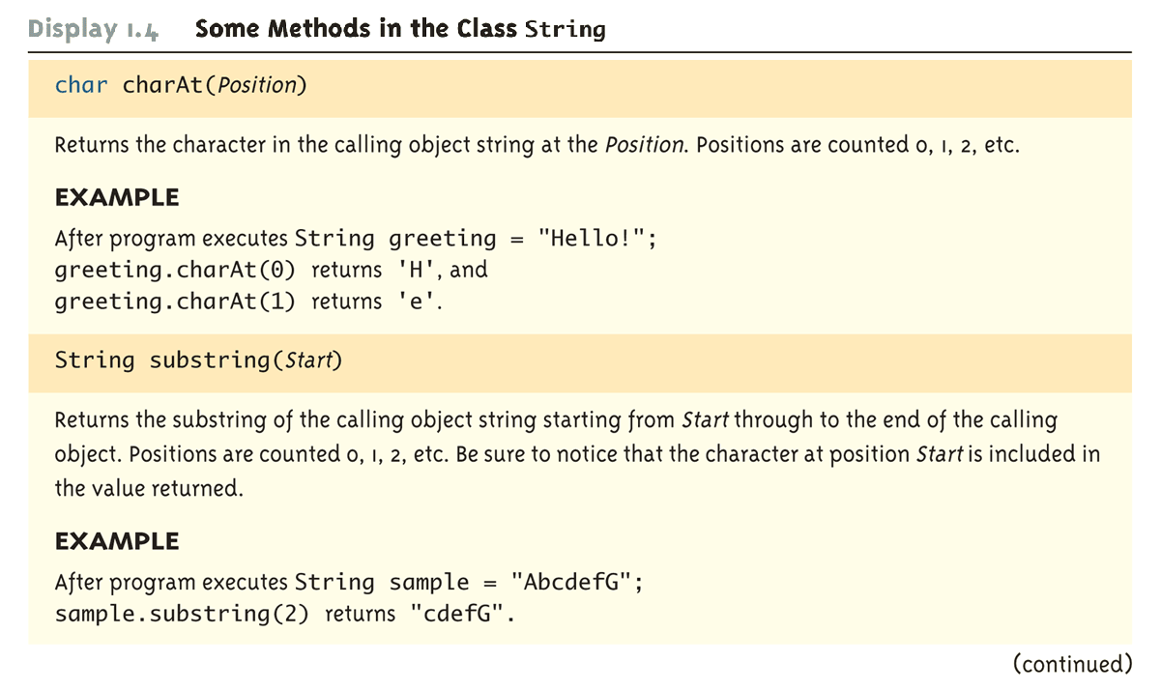
Some Methods in the Class String (Part 4 of 8)

Slide 72
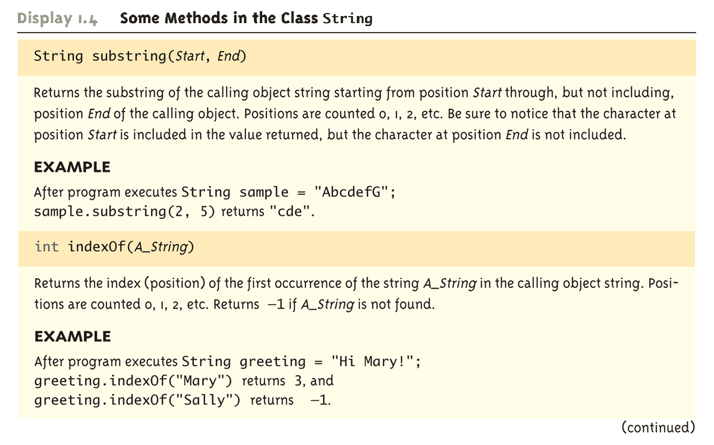
Some Methods in the Class String (Part 5 of 8)

Slide 73
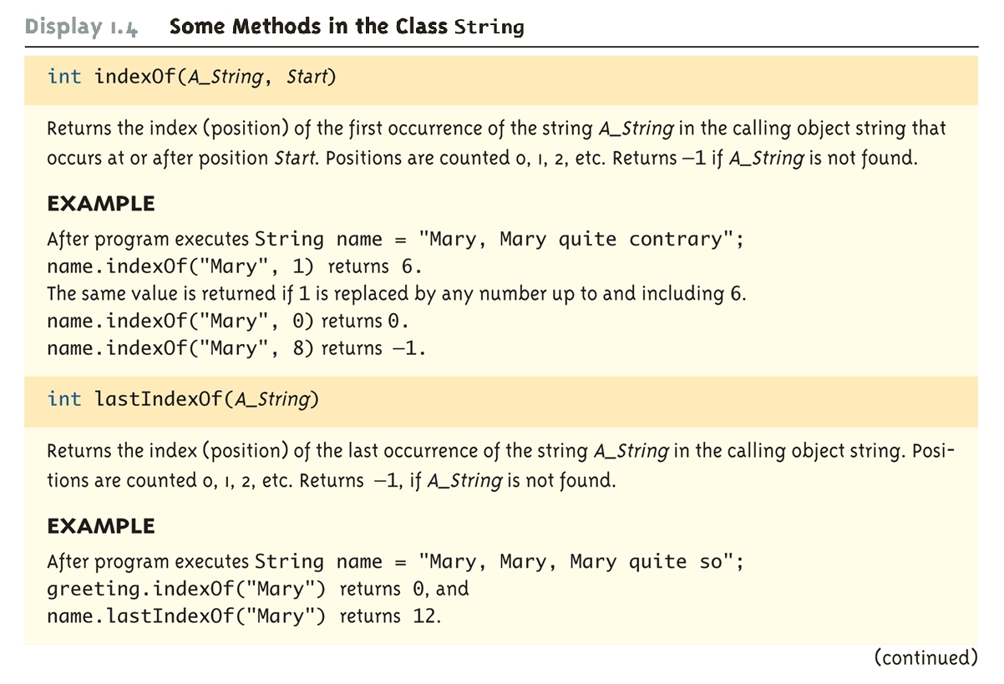
Some Methods in the Class String (Part 6 of 8)

Slide 74
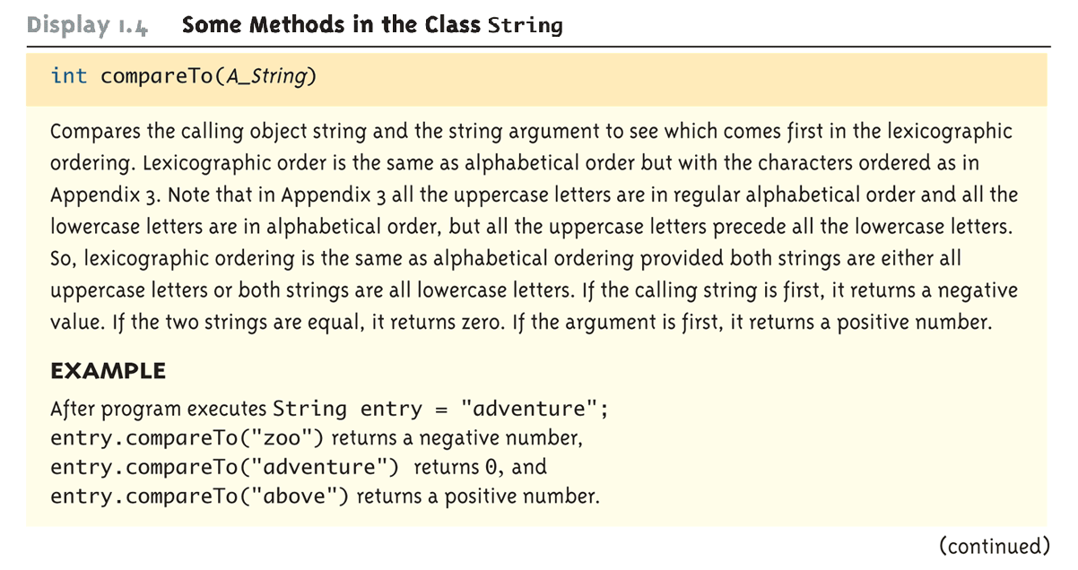
Some Methods in the Class String (Part 7 of 8)

Slide 75
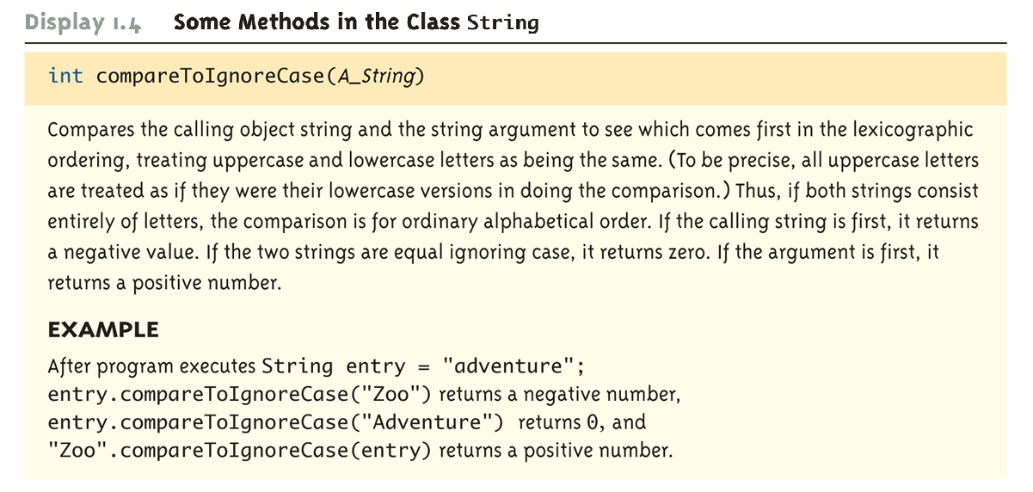
Some Methods in the Class String (Part 8 of 8)

Slide 76
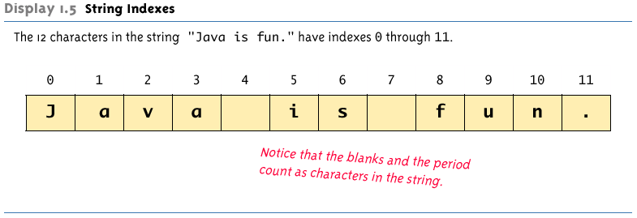
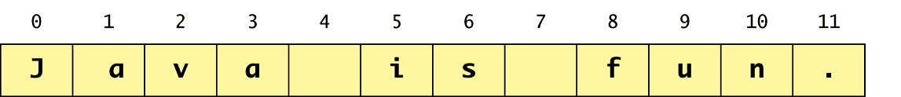
String Indexes

Slide 77
Escape Sequences
A backslash (\) immediately preceding a character (i.e., without any space) denotes an escape sequence or an escape character
The character following the backslash does not have its usual meaning
Although it is formed using two symbols, it is regarded as a single character

Slide 78
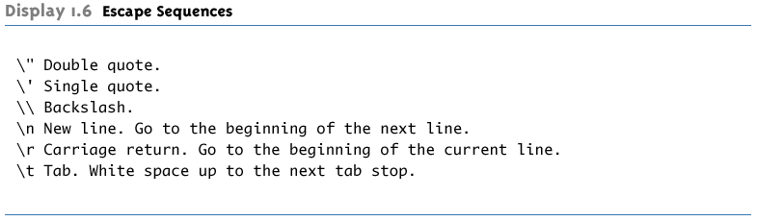
Escape Sequences

Slide 79
String Processing
A String object in Java is considered to be immutable, i.e., the characters it contains cannot be changed
There is another class in Java called StringBuffer that has methods for editing its string objects
However, it is possible to change the value of a String variable by using an assignment statement
String name = "Soprano";
name = "Anthony " + name;

Slide 80
Character Sets
ASCII: A character set used by many programming languages that contains all the characters normally used on an English-language keyboard, plus a few special characters
Each character is represented by a particular number
Unicode: A character set used by the Java language that includes all the ASCII characters plus many of the characters used in languages with a different alphabet from English

Slide 81
Naming Constants
Instead of using "anonymous" numbers in a program, always declare them as named constants, and use their name instead
public static final int INCHES_PER_FOOT = 12;
public static final double RATE = 0.14;
This prevents a value from being changed inadvertently
It has the added advantage that when a value must be modified, it need only be changed in one place
Note the naming convention for constants: Use all uppercase letters, and designate word boundaries with an underscore character

Slide 82
Comments
A line comment begins with the symbols //, and causes the compiler to ignore the remainder of the line
This type of comment is used for the code writer or for a programmer who modifies the code
A block comment begins with the symbol pair /*, and ends with the symbol pair */
The compiler ignores anything in between
This type of comment can span several lines
This type of comment provides documentation for the users of the program

Slide 83
Program Documentation
Java comes with a program called javadoc that will automatically extract documentation from block comments in the classes you define
As long as their opening has an extra asterisk (/**)
Ultimately, a well written program is self-documenting
Its structure is made clear by the choice of identifier names and the indenting pattern
When one structure is nested inside another, the inside structure is indented one more level
For details, read: book, the discussion in lab2

Slide 84
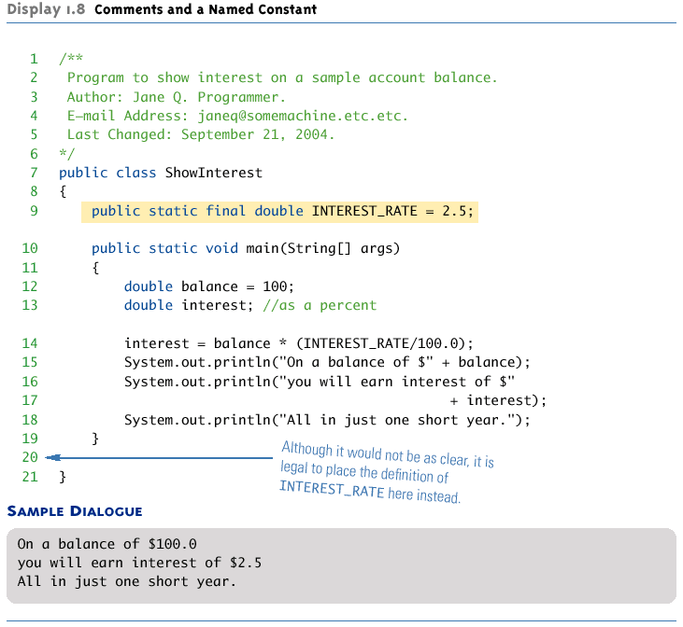
Comments and a Named Constant

Slide 85
Let’s Analyze this code
C
A
D
B
Q5. Name of a class?
E

Slide 86
Let’s Analyze this code
Q6. How many unique keywords are used?
A: 15
B: 12
C: 11
D: 6
E: 4

Slide 87
Let’s Analyze this code
Q7. How many variables of primitive data types are there?
A: 6
B: 5
C: 4
D: 3
E: 2

Slide 88
Let’s Analyze this code
Q8. How many unique methods are there?
A: 5
B: 4
C: 3
D: 2
E: 1

Slide 89
Let’s Analyze this code
Q10. How many literals of all types are there?
A: 10
B: 9
C: 8
D: 7
E: 6

